Slide 1
Organizational Security at Mayo Clinic
Presented By: Devin Young
CTEC 450 - Case Studies in Computer Security

Slide 2
Introduction
Mayo Clinic is the "largest integrated, not-for-profit medical group practice in the world" (About Us, n.d.).​
Top-ranked in more specialties than any other hospital and has been recognized as an Honor Roll member according to U.S. News & World Report's 2024-2025 "Best Hospitals" rankings (Top-ranked Hospital in the U.S. - About Us - Mayo Clinic, n.d.)​
Performs "basic, translational, clinical and epidemiological research at its campuses" (About Mayo Clinic Research, 2024)​

Slide 3
User Restrictions and Access Control Analysis
Measures of setting user restrictions and access controls are important within the healthcare industry because patient data and proprietary research must be safeguarded to maintain compliance with HIPAA
The “Privacy Rule of the Health Insurance Portability and Accountability Act of 1996 establishes national standards to protect individuals’ medical records and other personal health information” (Health Insurance Portability and Accountability Act of 1996 | CMS, n.d.)
“The HIPAA Privacy Rule also gives individuals rights over their health information, like getting a copy of their records and seeking correction” (Health Insurance Portability and Accountability Act of 1996 | CMS, n.d.)
Without user restrictions and access controls, unauthorized individuals can get access to confidential medical data

Slide 4
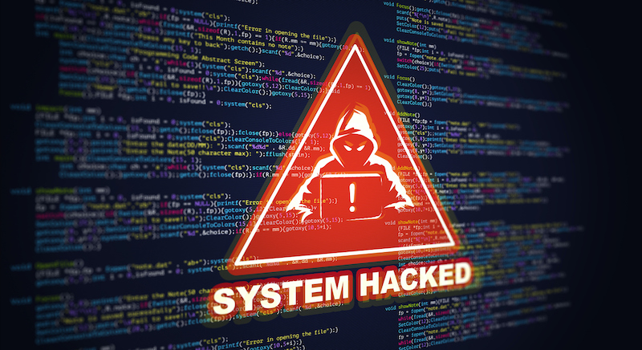
User Restrictions and Access Control Analysis (Continued)
Potential risks from inadequate user restrictions include:
The emergence of insider threats
Costly data breaches
Regulatory violations (resulting in fines and reputation damage)
Data manipulation
Intellectual property theft
An interruption in the organization’s business continuity process
(Rutherford, 2022)

Slide 5
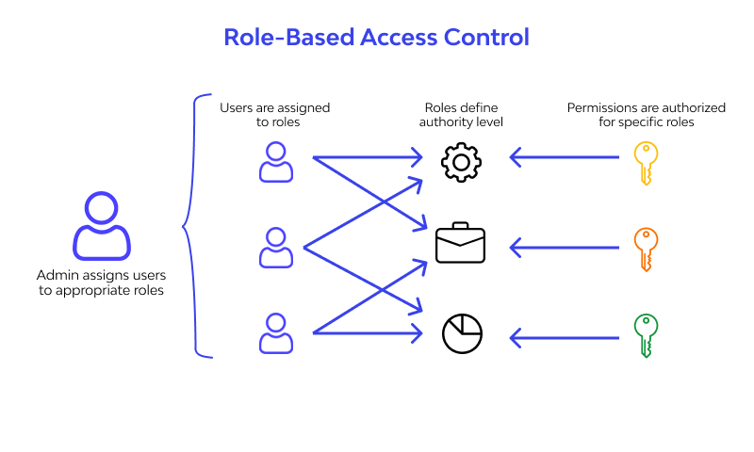
User Restrictions and Access Control Policy Proposals
The following user restrictions and access control mechanisms should be enforced within Mayo Clinic (healthcare industry):
Role-Based Access Controls
Two-factor authentication
Least privilege principle
Data segregation and Encryption (in transit and at rest)
Users must create strong complex passwords
Time-Based Access Controls
Badge-Based Authentication (physical security control)
(Lee, 2024)

Slide 6
User Restrictions and Access Control Policy Proposals - Justified
Role-based access controls ensure that users are granted access to information based on their role and what’s required for their role (mitigating unjustified and unauthorized access)
Two-factor authentication makes it so that even if unauthorized users have an employee or patient’s login information, they have to go through an extra step of verification to be granted access
Least privilege principles ensures that only those who need access to a specific set of data will have access to it, which makes it extremely harder for medical information to get into the wrong hands
With data segregation, data is organized so that it is easier to tell if it’s been manipulated and mitigates a scenario that would involve an incident going undetected for a long period of time

Slide 7
User Restrictions and Access Control Policy Proposals - Justified (Part II)
Data encryption (both in transit and at rest) is a layer of protection that would be used to prevent initial access and data manipulation within Mayo Clinic’s network enterprise infrastructure
Enforcing strong complex passwords will significantly decrease the likelihood of successful brute force attacks and password sprays
Time-Based Access Controls only allow users to access information at either a certain time or for a specific amount of time which helps identify when there are threat actors within a network enterprise infrastructure at Mayo Clinic
Badge-based authentication (physical security control) requires users to have the appropriate form of verification to gain access to what they’re attempting to access within Mayo Clinic’s physical facilities or network enterprise infrastructure

Slide 8
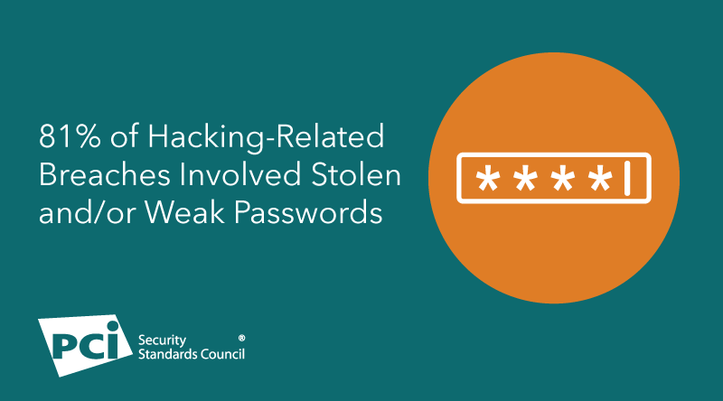
Password Standards and Requirements - Security Breaches caused by Weak Password Policies
Northern Irish Parliament - In 2018, the accounts of elected officials were compromised by a brute force attack, with hackers gaining access by using a list of commonly used passwords (Walker, 2023)
SolarWinds 123 - An intern created the password “SolarWinds123” on a server within SolarWinds and accidently made it publicly accessible through a private Github account (Afifi-Sabet, 2021)
1.5 Billion Records - “Cybersecurity Researcher, Jeremiah Fowler, discovered and reported to vpnMentor about a non-password protected database that held 1.5 billion records containing real estate ownership data of millions of people, including celebrities, politicians, and even his own personal information” (Fowler, 2023)
(Gray, n.d.)

Slide 9
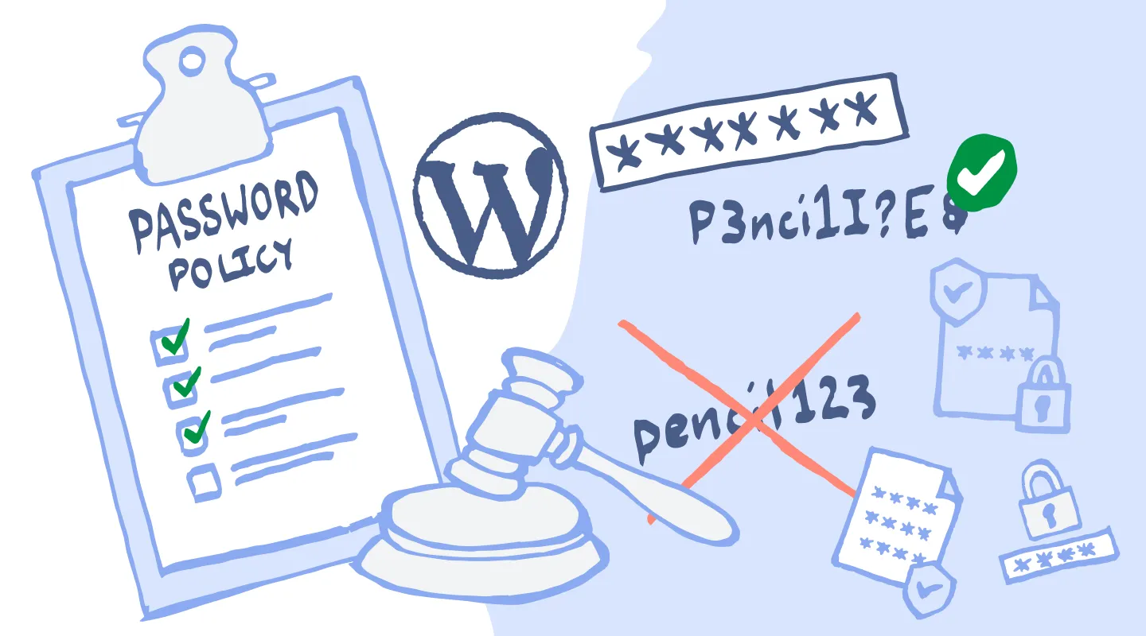
Password Standards and Requirements - Creation of Comprehensive Password Policy
Passwords within Mayo Clinic:
Must have at least 12 characters with uppercase, lowercase, and special characters
Must not replicate any common passwords
Should not include any name you go by, your age, or birthdate
Should not include the name, age, or birthdate of a relative
Should not be an exact copy of a password you already use
Must be updated/changed every 3 months
Must not be stored on the web, only in an approved password manager
Must be secured with two-factor authentication (Limited to Google Authenticator and Microsoft Authenticator…No Biometrics)
(Kumar, 2025)

Slide 10
Password Standards and Requirements - Challenges with Implementing the Proposed Password Policy at Mayo Clinic
Challenges:
Users could forget passwords often
Users could make minor changes to their passwords which weakens security
Strict password policies might hinder production in a fast-paced environment like the healthcare industry
Users may be prone to write passwords down on paper if they’re not very tech-savvy
Users may grow fatigue with having to update their passwords every 3 months

Slide 11
Shutting Down Unnecessary Services - Analysis
Consequences of leaving unnecessary services active on organizational networks:
Broader attack surface for threat actors
If those unnecessary services are not maintained, they will have unpatched vulnerabilities which could lead to an adversary infiltrating a network
Could expose sensitive data to the public
May violate security standards and fail audits that look for services to be secured
Can use up the network bandwidth, computing power, memory or disk space that’s needed for essential services
If a breach does occur as a result, there will be reputation damage
In addition, if a breach does occur there will be an increased costs for an incident response investigation

Slide 12
Shutting Down Unnecessary Services - Common Services that Pose Security Risks
When left running, common services that pose security risks include:
Telnet
File Transfer Protocol
Server Message Block (v1)
Universal Plug and Play
HTTP/HTTPS (Web Servers)
MySQL/Database Services
Simple Mail Transfer Protocol
NetBIOS

Slide 13
Strategy for Identifying and Shutting Down Unnecessary Services
Conduct regular audits that scan the network to identify services that are currently running and determine if they are needed or not
Use the principle of least privilege
When managing firewalls, restrict services that are unnecessary
If on an endpoint device, run commands to view all active processes and services
If on an endpoint device, run commands to disable the startup for a particular service
Document disable services and provide reasoning as to why the services are disabled

Slide 14
Benefits of Strategy for Identifying and Shutting Down Unnecessary Services
This strategy enhances security because:
All active services can be seen through audits which will help with choosing what services to eliminate
The principle of least privilege will help identify what services are not needed for the organization to run efficiently
Using firewalls to restrict services from running will ensure that those services are not ran, manually or dynamically
Running commands on endpoint devices to either disable a service or list all of the active services running allows an organization to monitor and manage individual endpoint devices to ensure that services get disabled on all endpoint devices and not just the majority
Documenting disabled services and providing reasoning as to why they’re disabled will help the organization keep track of what services are disabled and why they’re disabled in case a debate arises

Slide 15
Closing Unnecessary Ports Analysis
The importance of closing unnecessary ports:
“Network Ports are what computers use to communicate between one another” (Closing Unused Network Ports – North American Servicing, 2025), and they all have publicly known numbers to identify them, as well as specific technologies that run on them
With that being the case, “attackers also know what ports weak or vulnerable services typically run on” (Closing Unused Network Ports – North American Servicing, 2025)
Closing unnecessary ports is important because it will make it extremely harder for threat actors to intercept communication between networking devices and decrease the attack surface within Mayo Clinic’s network enterprise infrastructure

Slide 16
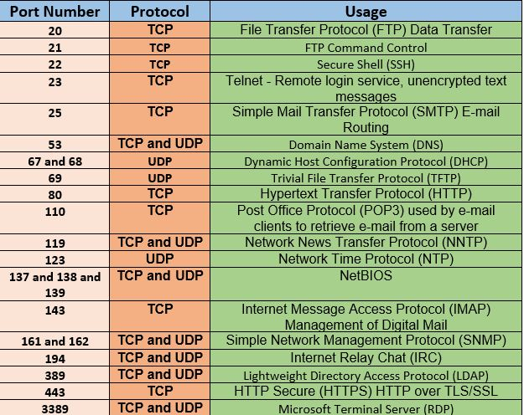
Closing Unnecessary Ports Analysis (Part II)
Ports commonly targeted in cyber attacks include:
Port 15 - NetStat (Ports and Its Security, n.d.)
Port 20/21 - FTP (Ports and Its Security, n.d.)
Port 22 - SSH (Ports and Its Security, n.d.)
Port 23 - Telnet (Ports and Its Security, n.d.)
Port 25 - SMTP (Ports and Its Security, n.d.)
Port 50/51 - IPSec (Ports and Its Security, n.d.)
Port 53 - DNS (Ports and Its Security, n.d.)
Port 80 - HTTP (Ports and Its Security, n.d.)
Port 137-139 - NetBIOS (Ports and Its Security, n.d.)
As well as many more!
(TCP/UDP Ports, 2020)

Slide 17
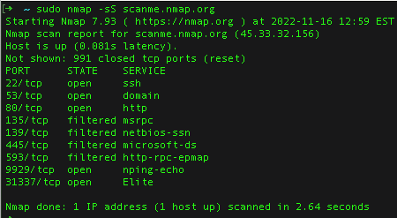
Proposal for Identifying and Closing Unnecessary Ports
Steps to identify and close unnecessary ports include:
Using the NMAP command to look for open network ports (Closing Unused Network Ports – North American Servicing, 2025)
Using the Netstat command to view open ports on an endpoint device (Closing Unused Network Ports – North American Servicing, 2025)
As for closing unnecessary ports, you can disable them or use a network firewall to prevent inbound network access by removing rules that allow inbound network access
(Closing Unused Network Ports – North American Servicing, 2025)
(Toole, 2022)

Slide 18
Impact of Proposal for Identifying and Closing Unnecessary Ports
The suggested process for identifying and closing unnecessary ports enhances security by:
Establishing port visibility for all network ports
Establishing port visibility on all endpoint devices
Providing a standard way of closing unnecessary ports, which is by manually disabling them or manually using a network firewall to

Slide 19
Conclusion
Cybersecurity is a strategy, and requires a balance between security and convenience
By disabling unnecessary ports and services, it allows an organization to focus more on securing ports and services that are essential to the organization’s operation efficiency
Developing strategies to secure network enterprise infrastructures can be difficult since threat actors know what ports, services, and technologies are likely to be vulnerable

Slide 20
Bibliography
About Mayo Clinic Research. (2024). Mayo Clinic. Retrieved October 31, 2024, from ​
https://www.mayo.edu/research/about/overview ​
About us. (n.d.). Mayo Clinic. https://www.mayoclinic.org/about-mayo-clinic​
Afifi-Sabet, K. (2021, March 1). SolarWinds blames intern for weak ‘solarwinds123’ password. ITPro.
https://www.itpro.com/security/cyber-attacks/358738/intern-blamed-for-weak-password-that-may-have-sparked-solarwinds
Closing Unused Network Ports – North American Servicing. Coalition. (n.d.).
https://help.coalitioninc.com/hc/en-us/articles/7770311581083-Closing-Unused-Network-Ports
Fowler, J. (2023, December 26). 1.5 Billion Records Leaked in Real Estate Wealth Network Data breach. Security InfoWatch.
https://www.securityinfowatch.com/cybersecurity/article/53081265/15-billion-records-leaked-in-real-estate-wealth-network-data-breach

Slide 21
Bibliography
Gray, L. K. (n.d.). Video: Strong Passwords. https://blog.pcisecuritystandards.org/video-strong-passwords
Health Insurance Portability and Accountability Act of 1996 | CMS. (n.d.). ​
https://www.cms.gov/about-cms/information-systems/privacy/health-insurance-portability-and-accountability-act-1996#:~:text=The%20Privacy%20Rule%20of%20the,and%20other%20personal%20health%20information. ​
Kumar, N. (2025, January 19). WordPress Password Policy: Enforcing strong passwords. Melapress.
https://melapress.com/wordpress-password-policy/
Lee, I. (2024, May 13). What is RBAC (Role-Based Access Control)? Wallarm.
https://www.wallarm.com/what/what-exactly-is-role-based-access-control-rbac
Ports and its security. (n.d.). https://www.w3schools.in/cyber-security/ports-and-its-security

Slide 22
Bibliography
Rutherford, Dr. A. J. (2022, October 25). Open Source Intelligence: How Hackers Gather your
Information. EDGE.
https://amuedge.com/open-source-intelligence-how-hackers-gather-your-information/
TCP/UDP Ports. ITPerfection. (2020, September 24).
https://www.itperfection.com/network-security/tcp-udp-ports-network-ssh-ftp-ftps-dhcp-dns/
Toole, M. (2022, December 23). How To Use Nmap To Scan For Open Ports. Blumira.
https://www.blumira.com/blog/using-nmap
Top-ranked hospital in the U.S. - About Us - Mayo Clinic. (n.d.). ​
https://www.mayoclinic.org/about-mayo-clinic/quality/top-ranked ​
Walker, C. (2023, May 4). The Top 4 Instances When a Weak Password Led to a Major Hacking Incident. Cybernews.
https://cybernews.com/security/cost-of-week-password-hacking

